Slide 1
Cloud computing

Slide 2
Before Cloud Computing
Suppose you want to host a website, there are the following things that you would need to do:
Buy a stack of servers
High traffic..! More servers
Monitoring and Maintain servers

Slide 3
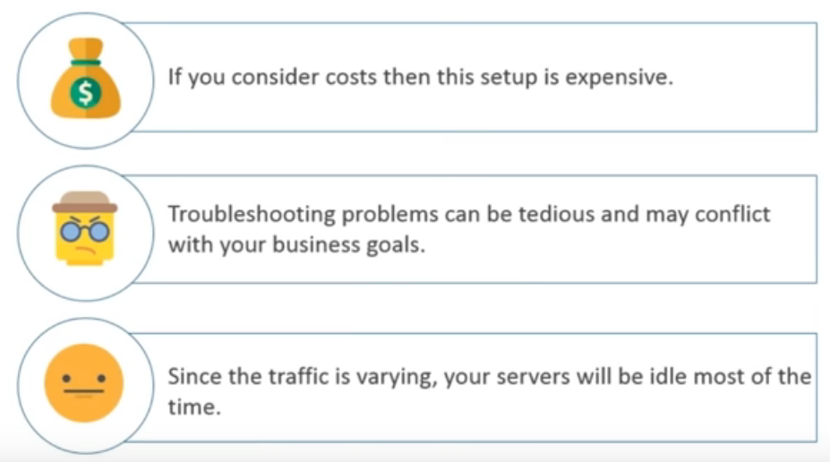
Disadvantages

Slide 4
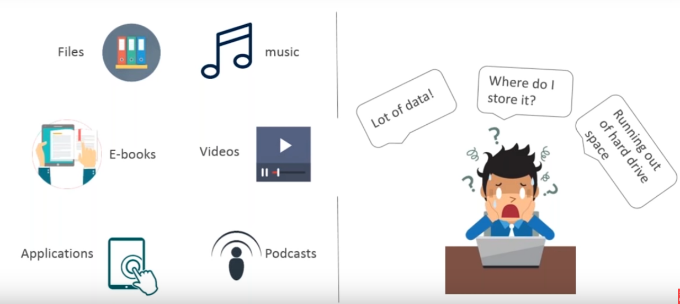
Why Cloud?

Slide 5
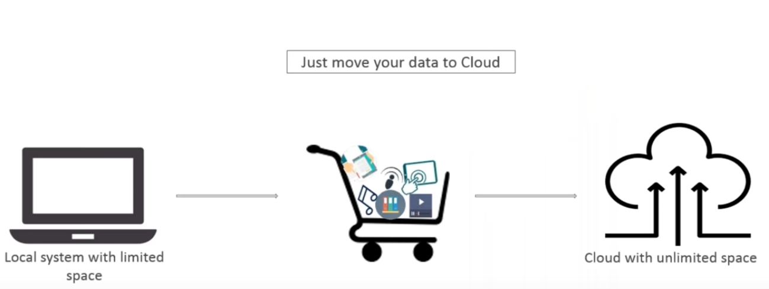
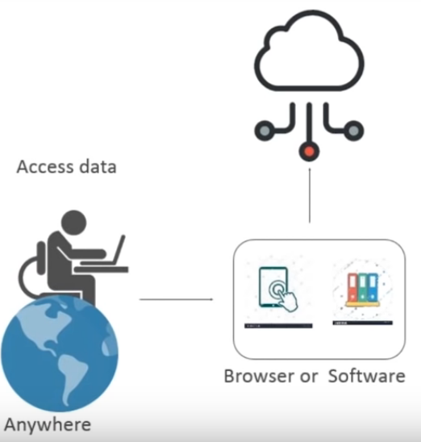
Why Cloud? ……
Cloud computing is:
Storing data/applications on remote severs
Processing data/applications from servers
Accessing data/applications via internet

Slide 6
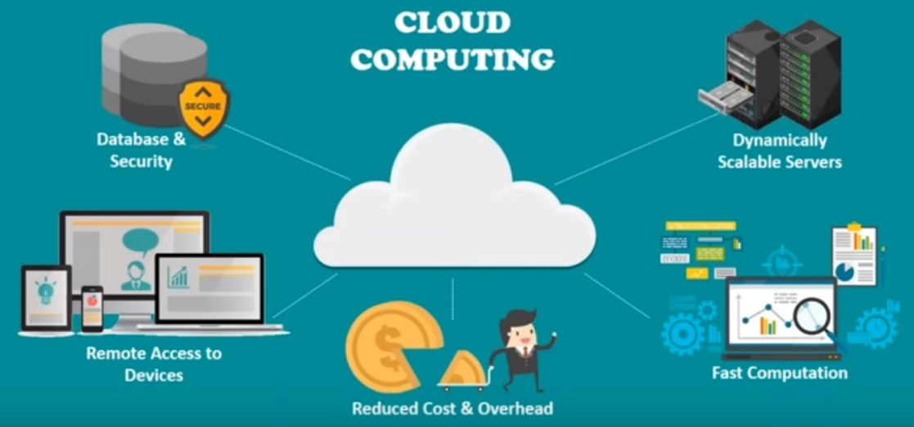

Slide 7
What is Cloud?
Cloud computing is the on-demand delivery of compute power, database storage, application, and other IT resources through a cloud service platform via the internet with pay-as-you-go pricing.
It is the use of remote servers on the internet to store, manage and process data rather than a local server or your personal computer.

Slide 8
What is Cloud?
Cloud computing means storing and accessing data and programs over the Internet instead of your computer's hard drive. The cloud is just a metaphor for the Internet.
You do not install anything on your desktop, and you do not pay for the technology when you are not using it.
The cloud is something more than the internet.
The cloud can be both software and infrastructure.

Slide 9
What it Provide?
Cloud computing provides shared services as opposed to local servers or storage resources
Enables access to information from most web-enabled hardware
Allows for cost savings – reduced facility, hardware/software investments, support

Slide 10
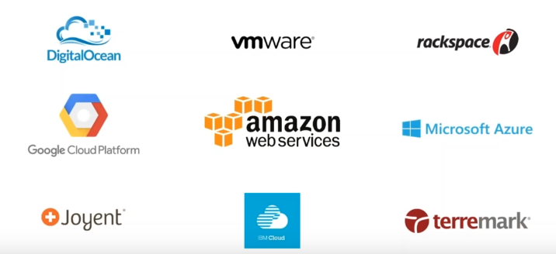
Cloud providers

Slide 11
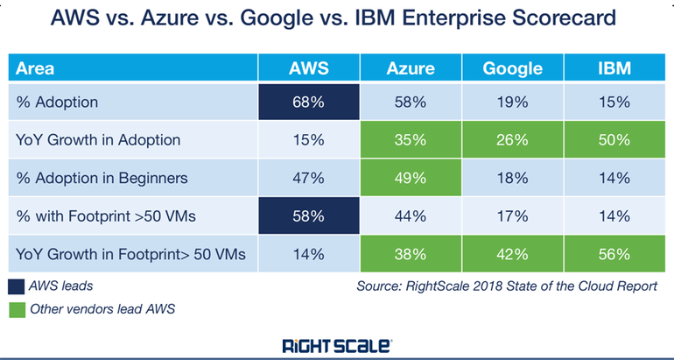

Slide 12
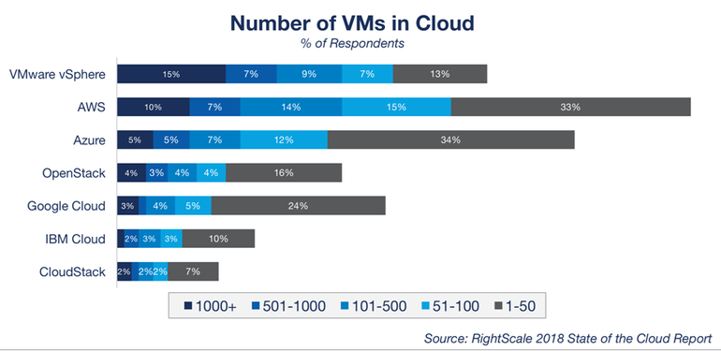

Slide 13
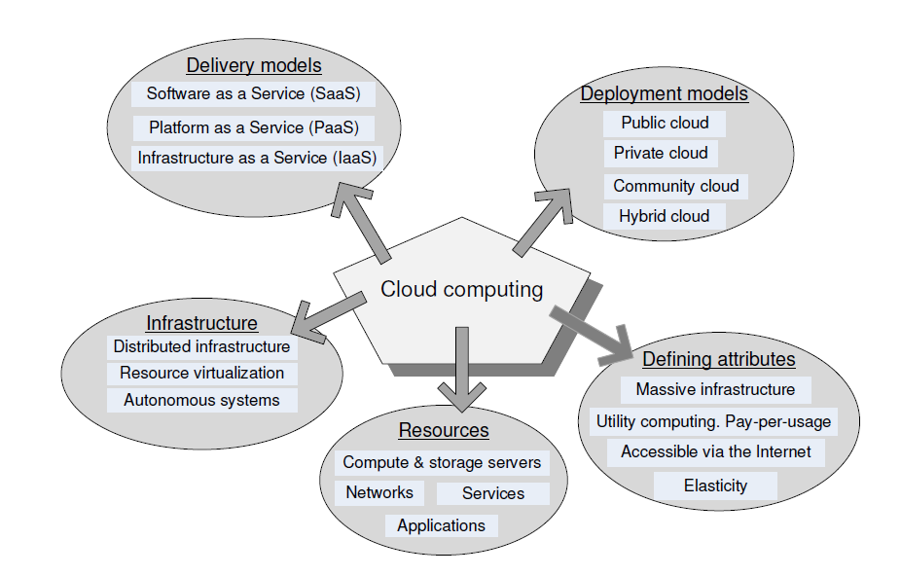
0

Slide 14
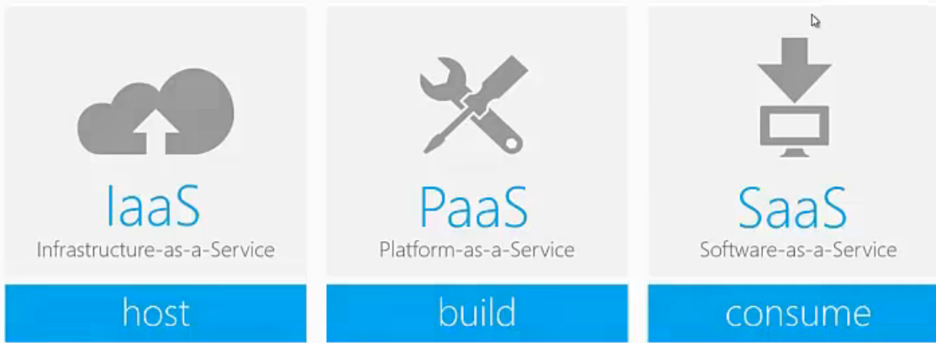
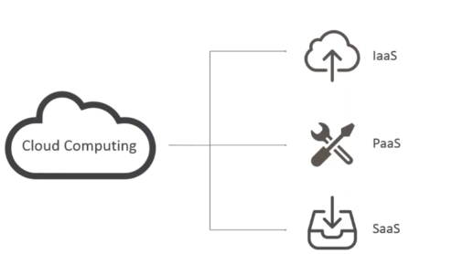
Service Models: Cloud Computing

Slide 15
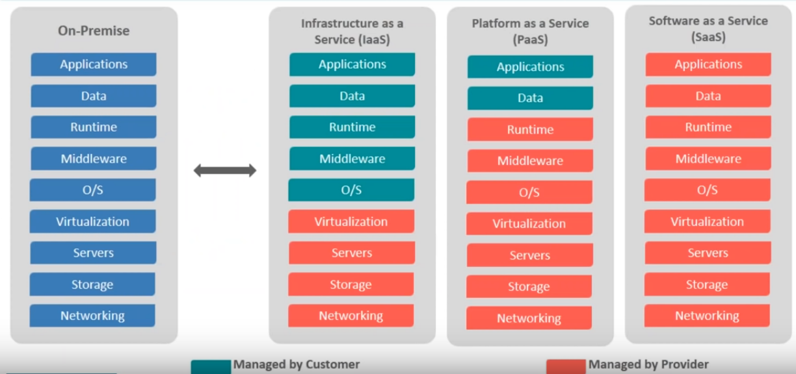
Cloud services

Slide 16
Cloud Service Models
Cloud Software as a Service (SaaS) – Google Docs
A software is given to you in form of services
Cloud provider leases applications or software which owned by them to its client
User doesn’t manage or control the network, servers, OS, storage or applications e.g. Google apps, saleforces.com
Many companies runs different software as a package in form of service.

Slide 17
SaaS
Software
Google Docs
Java
Javascript
Infrastructure
Servers
?
Network Connection

Slide 18
Platform as a Service (PaaS)
Cloud Platform as a Service (PaaS) – Heroku
AWS
Users deploy their applications on a cloud
Users control their apps
No control over the underlying architecture including OS, Storage, Servers etc.
The cloud provider gives the ability to the customer to deploy customer created apps using programming languages, tools etc. that are provided by the Cloud Provider

Slide 19
PaaS
Software
Platform
Ruby on Rails
Debian Linux
Infrastructure
Servers
Thin
PostgresSQL
Network Connection
Your Application

Slide 20
Infrastructure as a Service (IaaS)
Cloud Infrastructure as a Service (IaaS) - Rackspace
Rent processing, storage, network capacity, and other fundamental computing resources
Consumers gets access to the infrastructure to deploy their stuff
Don’t manage or control the infrastructure (no worries about the underlying physical machine)
Do manage or control the OS, storage, apps, selected network components (abstract the user from physical machine)

Slide 21
Software
Platform
Your Programming Language
Your Operating System
Infrastructure
Servers
Your Database
Network Connection
Your Application

Slide 22
IaaS Example
at&t
Blizzard
Go Grid
OpSource

Slide 23
PaaS Example
Azure
Amazon web servicies
Saleforces.com
Rackspace
Joyent

Slide 24
SaaS Example
Google doc
Facebook
Netsuite
postini

Slide 25
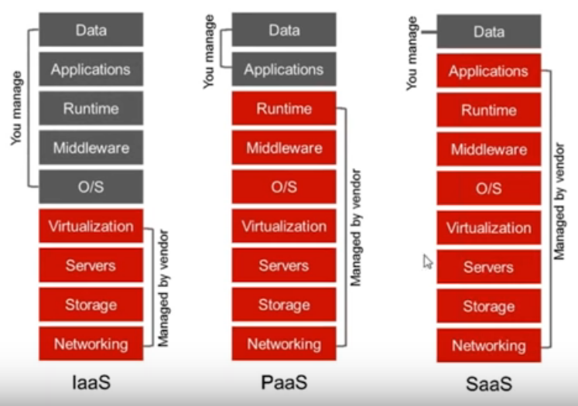

Slide 26
Service Model Architectures

Slide 27
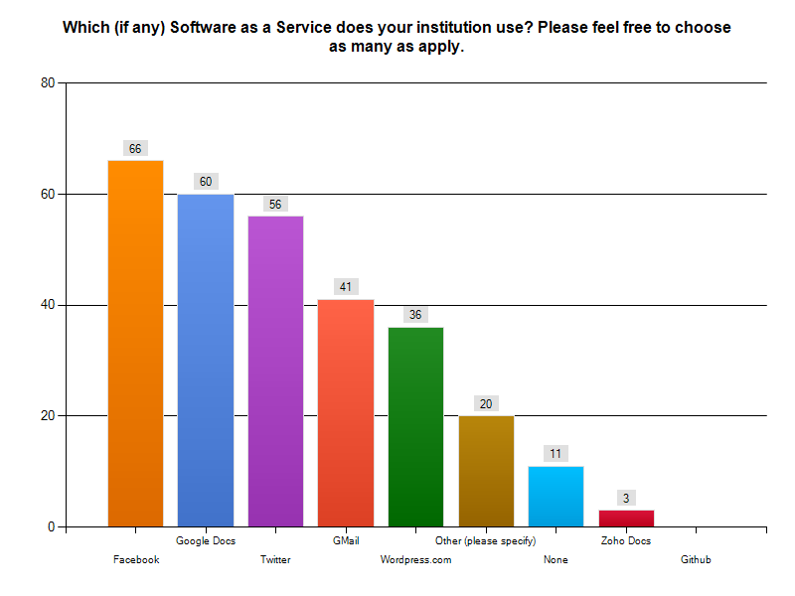
Software-as-a-Service
Usage by Academic Institutions Responding to Survey

Slide 28
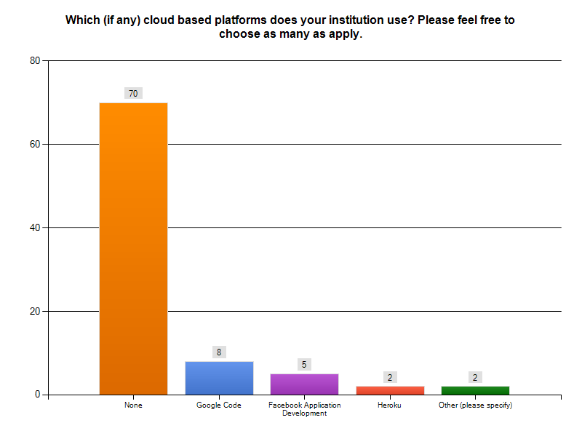
Platform-as-a-Service
Usage by Academic Institutions Responding to Survey

Slide 29
Infrastructure-as-a-Service
Usage by Academic Institutions Responding to Survey

Slide 30

Private Cloud
Implementation of cloud services on resources that are dedicated to your organization, whether they exist on-premises or off-premises
Typically, your organization owns and controls the resources/assets, definition of services, costs and risks
Variations exist – such as hosted and virtual private clouds
rivate clouds
Microsoft solutions
Windows Server 2008 R2 Hyper-V, System Center (IaaS)
Windows Azure Appliance (PaaS)

Slide 31


Hybrid Cloud
Mixed/blended model of private and public clouds
Variations and multiple interpretations exist
On-premises and off-premises bridging
Most common scenario today
Especially for large enterprises
More than a deployment / delivery model
Application design, architectural model
+

Slide 32
Public Cloud
Implementation of cloud services on resources that are shared between many customers, managed off-premises
Typically, cloud provider owns and controls the resources/assets, definition of services, costs and risks
Variations exist – such as hosters and integrated cloud platforms
Microsoft solutions
Office 365 (SaaS)
Dynamics CRM Online (SaaS)
Windows Intune (SaaS)
Windows Azure platform (PaaS)

Slide 33
Deployment Models
Public Cloud
Amazon Web Service’s
Elastic Compute Cloud
Software
Platform
Infrastructure
Redmine
Ruby on Rails
Servers
Ubuntu
MySQL
Network Connection
Mongrel

Slide 34
Community Cloud
Educational Consortium’s
Cloud
Software
Platform
Ruby on Rails
Ubuntu
Infrastructure
Servers
MySQL
Network Connection
Redmine
Mongrel

Slide 35
Private Cloud
Institution’s
VMware vCloud
Software
Platform
Ruby on Rails
Ubuntu
Infrastructure
Servers
MySQL
Network Connection
Redmine
Mongrel

Slide 36
Hybrid Cloud
VMware vCloud
Amazon Web Service’s
Elastic Compute Cloud
Platform
MySQL
Software
Platform
Ruby on Rails
Ubuntu
Infrastructure
Servers
MySQL
Network Connection
Redmine
Mongrel

Slide 37
Resources on the Cloud: Blogs
Planet Cloud
an aggregation of blogs talking solely about the cloud
Wisdom of the Clouds
James Urquhart, Market Manager for Cloud Computing and Virtualization, CISCO
Rational Survivability
Christopher Hoff, Director of Cloud and Virtualization Solutions, Data Center Solutions, CISCO
Amazon Web Services Blog
Official blog for Amazon Web Services
Windows Azure Blog
Official blog for Windows Azure
Elastic Vapor :: Life in the Cloud
Reuven Cohen, Founder and CTO Enomaly Inc.
All Things Distributed
Werner Vogels, CTO Amazon.com

Slide 38
Resources on the Cloud
NIST Definition of the Cloud
The National Institute of Standards and Technology’s definition of the cloud.
Above the Clouds: A Berkeley View of Cloud Computing
A paper on the potential benefits and uses of the cloud
Clouderati Twitter Lists
While Clouderati itself doesn’t tweet about the cloud, it does provide a number of lists of persons that tweet about the cloud. While many of these folks are in the business space, they provide a lot of information about the cloud.
EDUCAUSE Cloud Computing Resources
Resources from education on cloud computing, including publications, presentation, podcasts, etc.
Attend CloudCamp
CloudCamp is an unconference held throughout the world (and even virtually). It’s a great place to go, meet people who are also interested in the cloud, and learn a few new things.

Slide 39
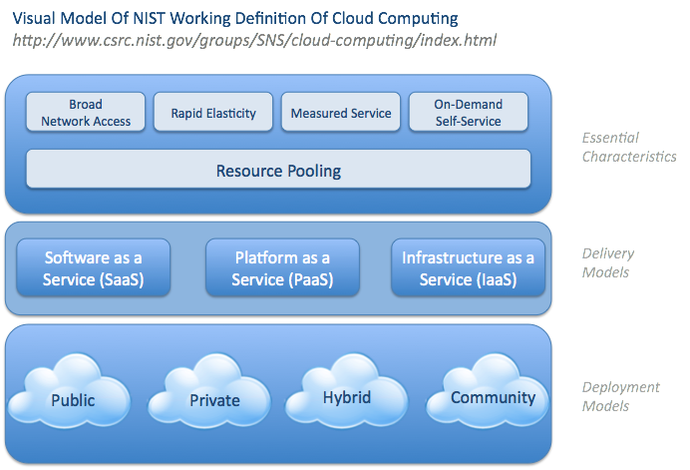

Slide 40
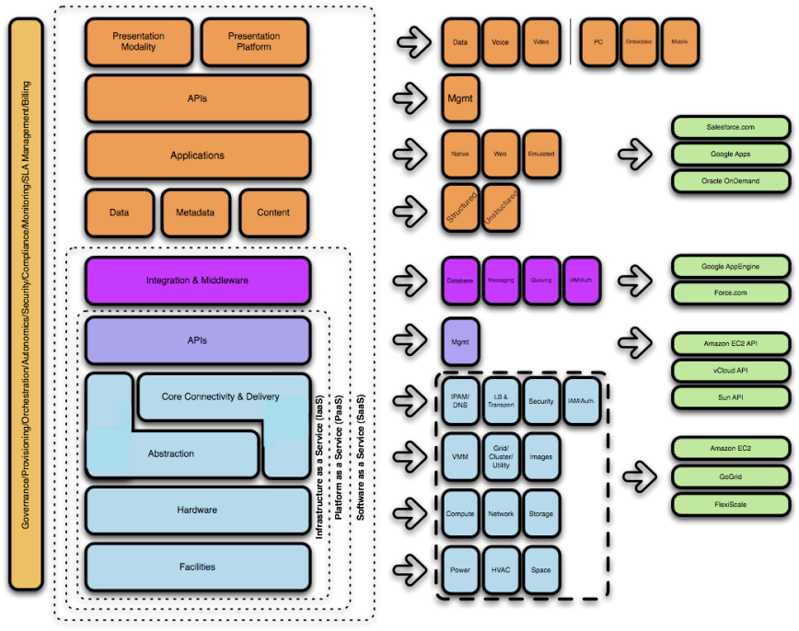

Lots Of *aaSes...Variations On a Theme
Storage as a Service
Database as a Service
Information as a Service
Process as a Service
Integration as a Service
Security as a Service
Management as a Service
Testing as a Service...

Slide 41

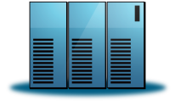
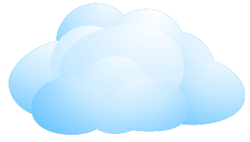


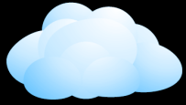


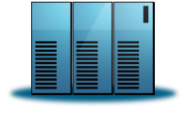




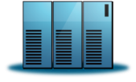
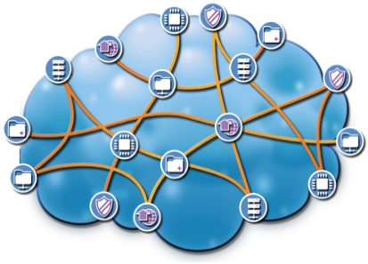

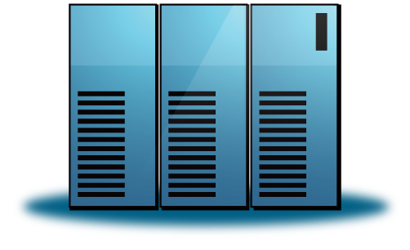




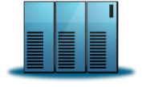



Laying Out the Timeline...
Phase 1
Phase 2
Phase 3
Phase 4
Private Cloud
Private Cloud
Open Cloud
Private Cloud
Private Cloud
Virtual Private Cloud
Hybrid Cloud
Inter-Cloud
Inter-Cloud
Stand-Alone
Data Centers
Public Cloud
Public Cloud
Public Cloud #1
Public Cloud #2
PRESENT
~2015-2017

